Slide 1
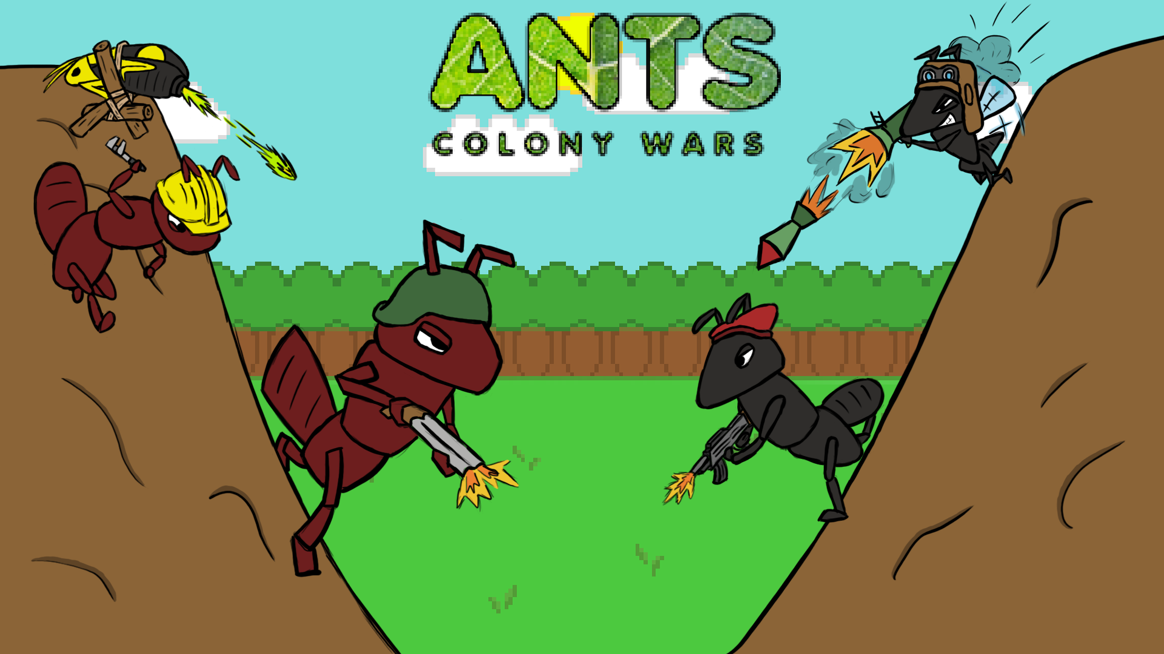

Slide 2
Game Synopsis (Stanley)
CAKE

Slide 3
Features in more detail (Stanley)

Slide 4
Gameplay from each level 1 (Stanley)

Slide 5
Gameplay from each level 2 (Stanley)

Slide 6
Concept art from paper to engine (Harry)

Slide 7
Sprites and characters (Harry)

Slide 8
Level design from concept to engine (Stanley)

Slide 9
Extra features added (Danny)

Slide 10
Bugs – Coding (Gary)

Slide 11
Bugs – Graphics (Gary)
Original picnic table – fixed by recreating in Maya or 3ds MAX
Sprite animations not playing properly
If the level isn’t even the ants can fall off
Character gets sent flying if it stands on a destructible bit of terrain

Slide 12
Conclusion (Danny)
What we learnt
Team dynamics
What went well
What could’ve been better – SSADRFTSUYGHAIOKJL:DP@ SAD
How we fell about the game – works for tdemo, given more time + resources = better game. If second time better learnt due to working earlier

